Slide 1


RuleRunners: A Two-Player Collaborative Software Tool for Introducing Rule-Based AI Systems to Middle School Students
Pragathi Durga Rajarajan, Dr. Fred Martin
Additional materials (code repository, live link to RuleRunners, paper link, and this presentation) can be found at https://tinyurl.com/RuleRunners-SIGCSEV2026 or at the QR code to the right

Slide 2
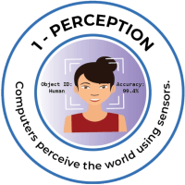
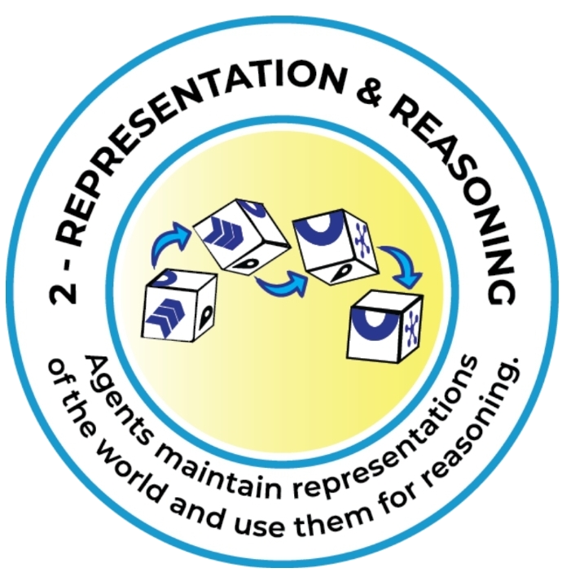
Background
K-12 AI literacy is increasingly important
Rule-based AI education
  Bridge between computational thinking and ML concepts
  Aligns with AI4K12’s Big Ideas 1 and 2
Need for accessible, engaging, and interactive software tool
Pragathi Durga Rajarajan, Dr. Fred Martin

Slide 3

Research Questions
(RQ1) How does RuleRunners impact student learning of rule-based systems?
(RQ2) How do students compare rule-based systems and machine learning models?
(RQ3) How engaging is the two-player collaborative/competitive design of RuleRunners?
Pragathi Durga Rajarajan, Dr. Fred Martin

Slide 4
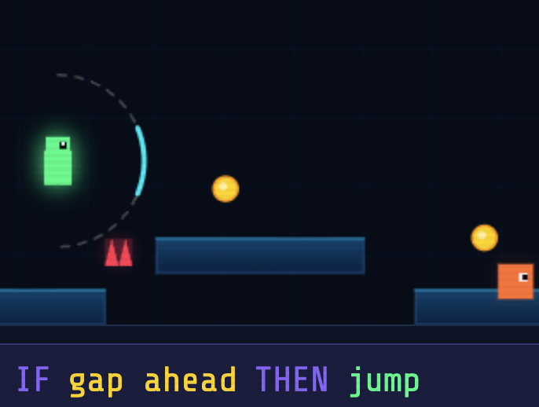
RuleRunners Tool Design
Rule-Based AI Introduction Page
Practice Walkthrough Level
Collaborative Walkthrough Level
Build Agent Level
Competition Level
Story Builder Page

Slide 5
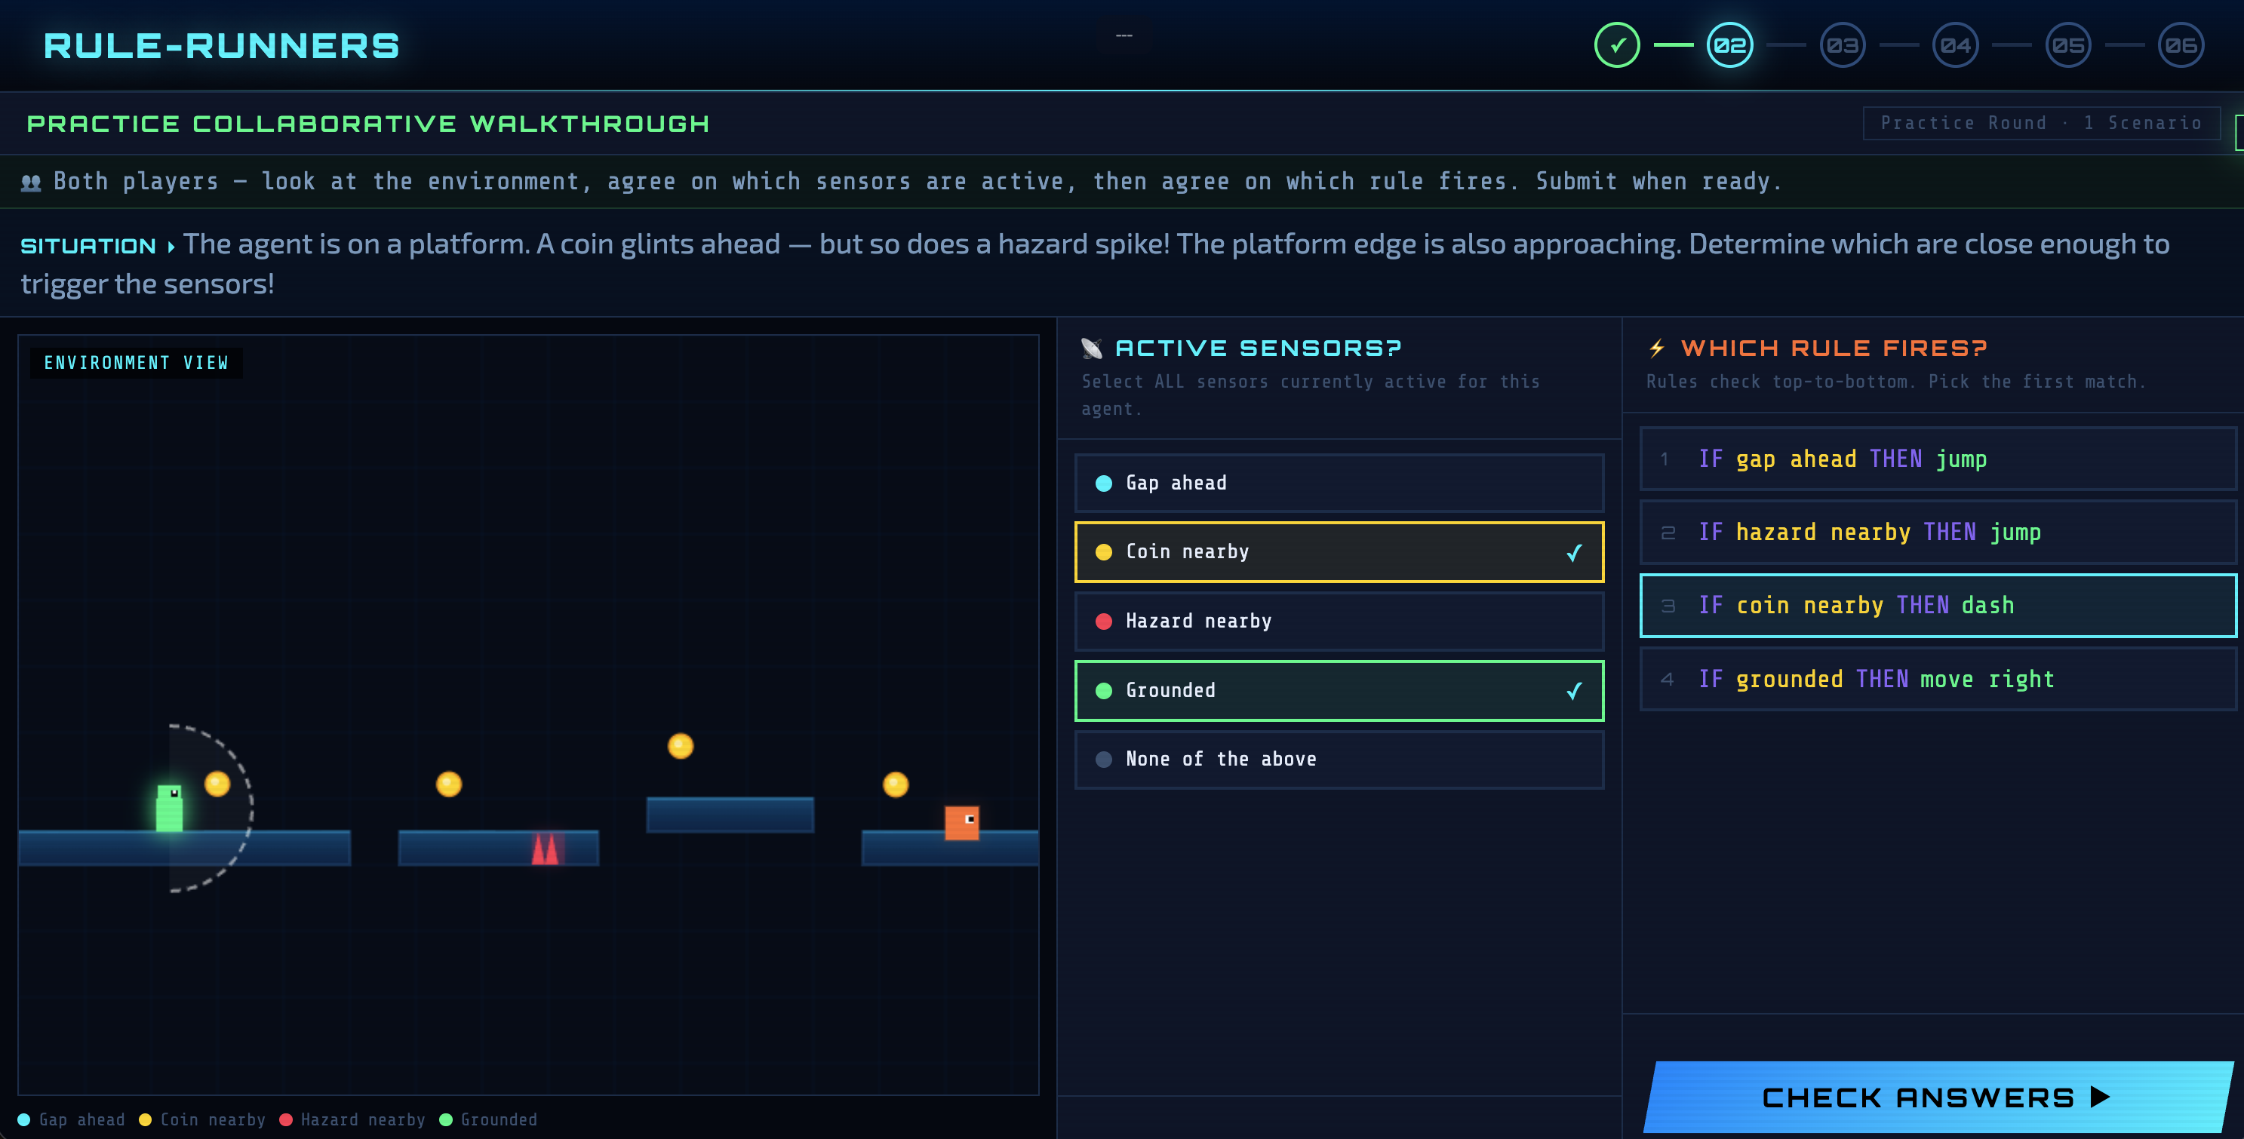
RuleRunners Tool Design

Slide 6
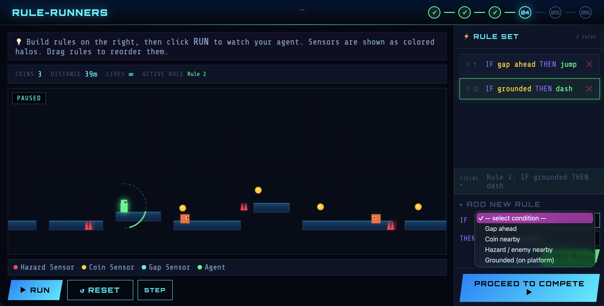
RuleRunners Tool Design

Slide 7
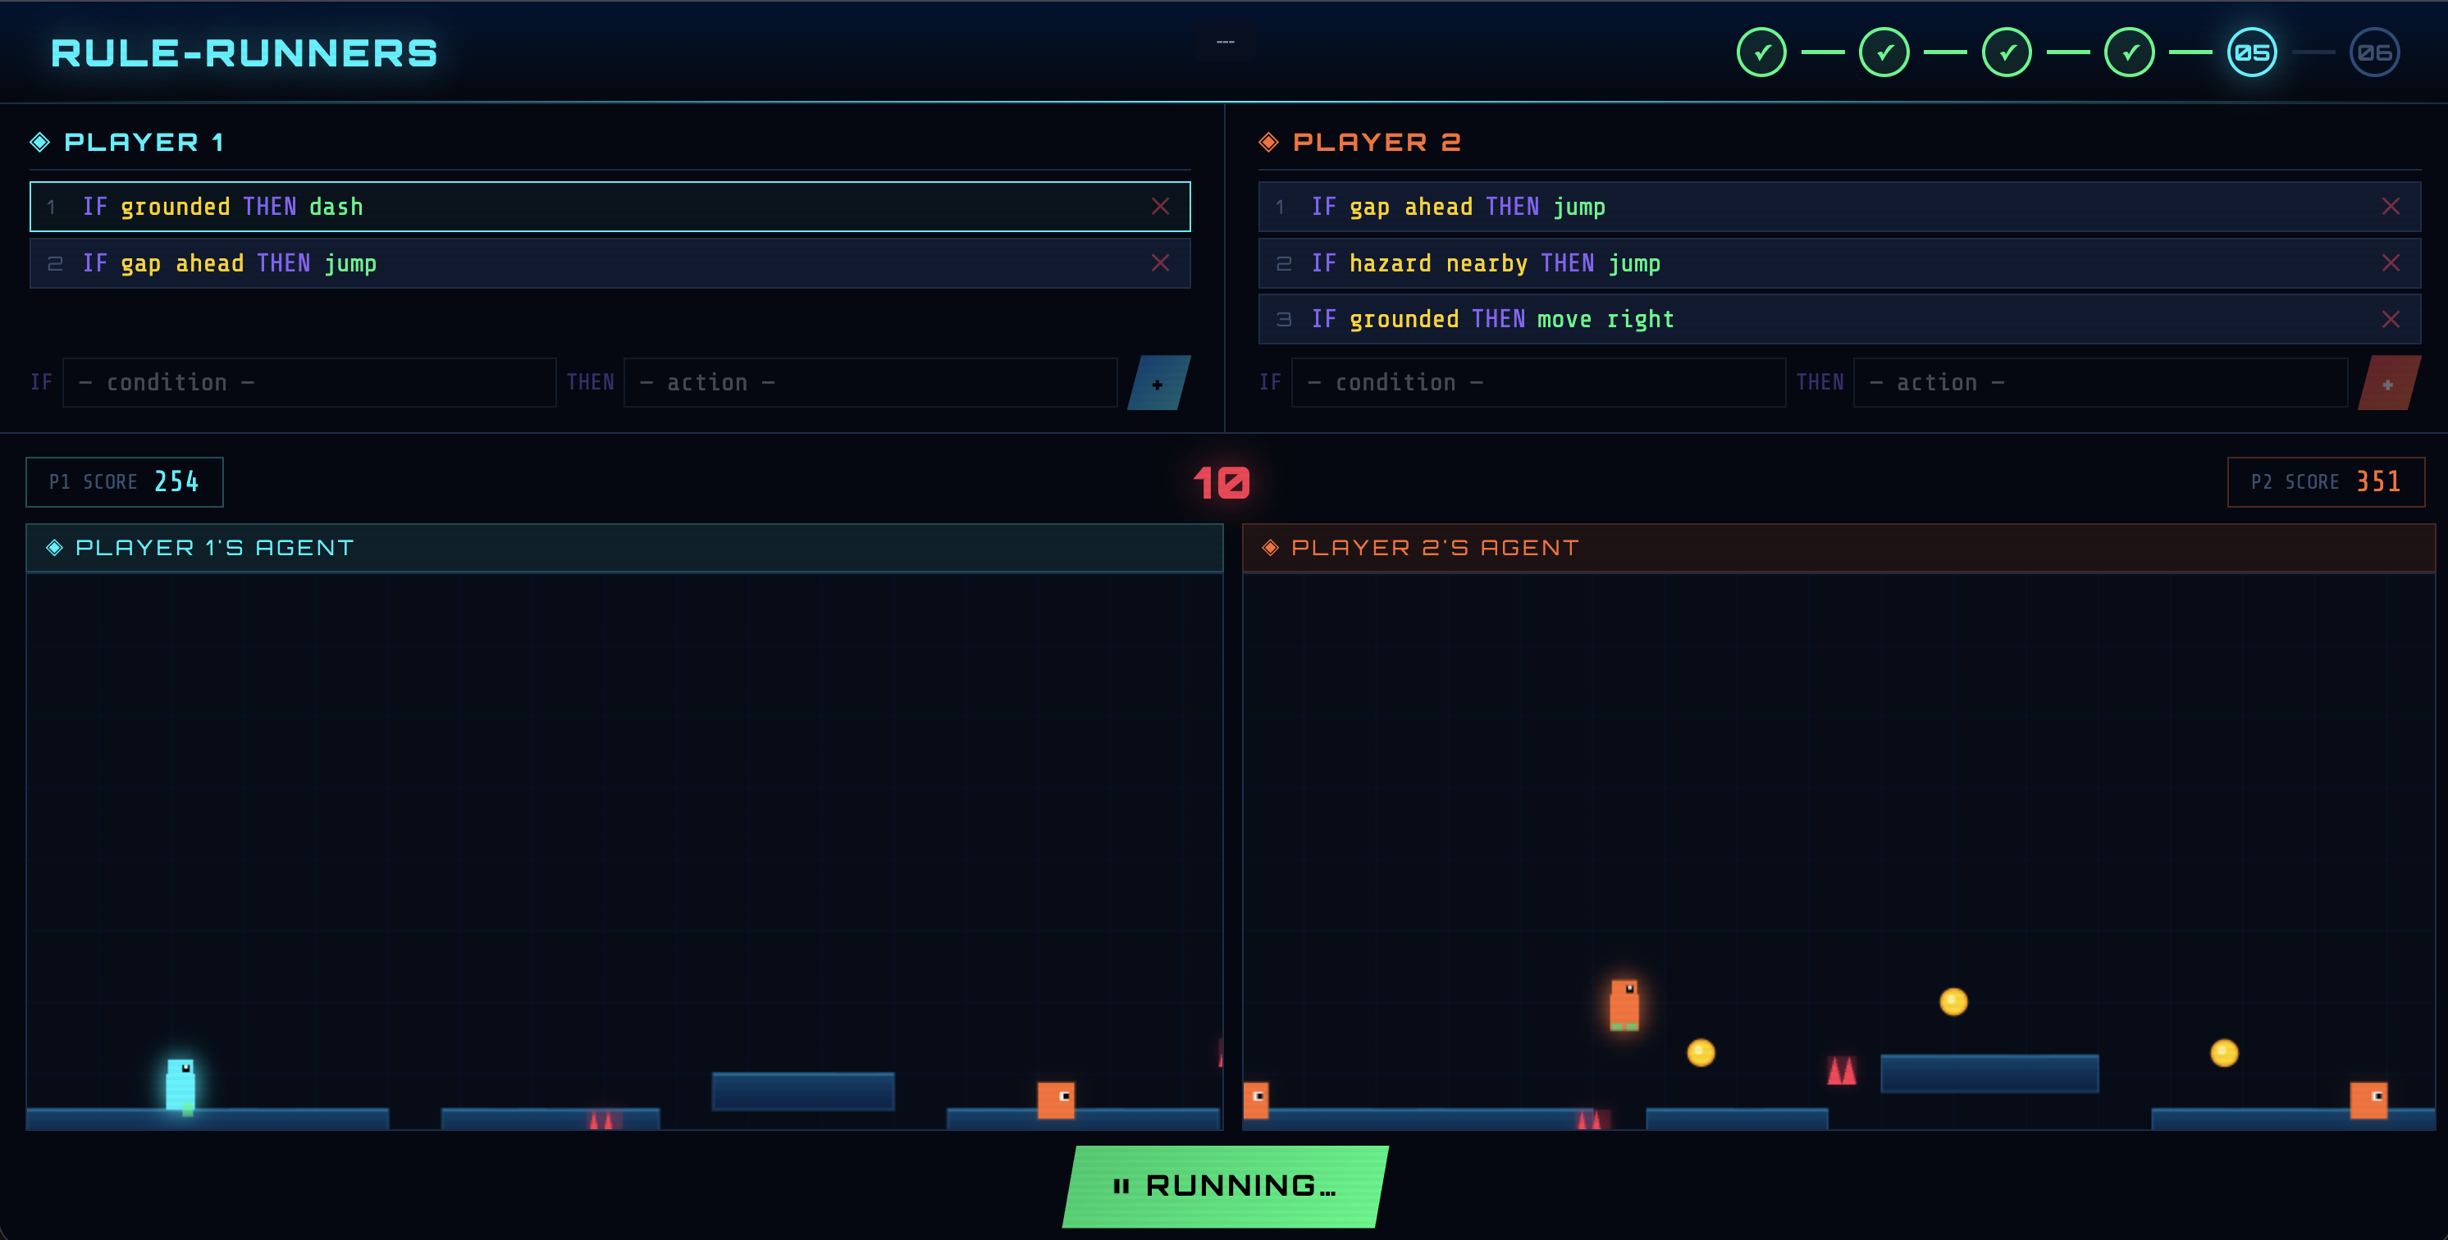
RuleRunners Tool Design

Slide 8
Study Design
10 AI educational software tools were tested
Participants: Secondary Students (ages 13-14)
Location: STEM Magnet school in a major city in Texas, United States
Students rotated between the software tools every 8-10 minutes
Data Collection
  Collective pre-survey
  RuleRunners Website Interaction Data
  Audio/Screen Activity
  Post-survey
Pragathi Durga Rajarajan, Dr. Fred Martin

Slide 9
Results – (RQ1) How does RuleRunners impact student learning of rule-based systems?
Multiple Choice Item | Correct (%)
What are rules made of? | 60.3 %
What does the system use to detect conditions in the environment? | 68.7 %
When the conditions of multiple rules are met simultaneously, what happens? | 80.9 %
Identifying which option was a real-world application of rule-based AI | 74.6 %
What is the main difference between a rule-based system and an AI model that learns? | 77.9 %
Student performance on some post-survey multiple choice items
Pragathi Durga Rajarajan, Dr. Fred Martin

Slide 10
Results – (RQ2) How do students compare rule-based systems and machine learning models?
Category | No. | Sample Response
Reliable, safe, transparent | 17 | “All the actions are controlled and can be traced back to a specific rule.”
Human controlled | 12 | “Humans have complete control.”
Efficient | 12 | “It is simpler to create and easier to manage over time.”
Misconception that it learns | 4 | “it has fixed rules but learns over time”
Trivial | 7 | “good”
Inaccurate | 4 | “Yes, it will criticize things”
No Response | 12
Categorized responses to post-survey item asking, “What are advantages of rule-based AI over AI that learns?”
Pragathi Durga Rajarajan, Dr. Fred Martin

Slide 11

Results – (RQ3) How engaging is the two-player collaborative/competitive design of RuleRunners?
Collaborative Interaction
  “we” phrasing
  Partner discussions
  Interaction during Story Builder
Competitive Interaction
  Competition level
  “Playful trash talk”
Enjoyment (fun ratings on scale 0-5)
  All levels scored ≥ 3.0
  Competition Level: $μ$ = 3.92
  Collaborative Walkthrough Level: $μ$ = 3.87
  Overall: $μ$ = 3.54 ($σ$ = 0.87)
Pragathi Durga Rajarajan, Dr. Fred Martin

Slide 12
Limitations and Future Work
Limited sample size
Noisy audio recordings limited collaboration analysis
Expand condition and action options for more complex examples
Pragathi Durga Rajarajan, Dr. Fred Martin

Slide 13
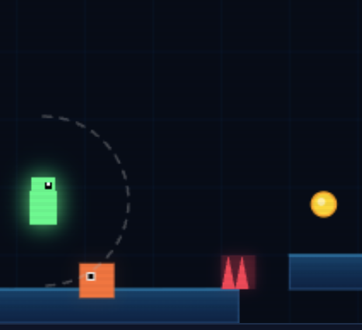
Discussion and Conclusion
Open-source web application on rule-based AI
  Two-player single-device format
Successful aspects
  Collaboration and enjoyment
  Students understood some basic rule-based AI concepts
  Students compared ML and rule-based systems
Gamified, low-barrier introduction to rule-based AI
Pragathi Durga Rajarajan, Dr. Fred Martin

Slide 14
Questions?
Additional materials (code repository, live link to RuleRunners, and paper link) can be found at https://tinyurl.com/RuleRunners-SIGCSEV2026 or at the QR code to the right
Acknowledgments
We are grateful to the members of the Engaging Computing Group at the University of Texas at San Antonio for their feedback and support
We would like to thank the administrators and staff who made the after-school sessions possible. We also thank the students who participated in the study
This material is based upon work supported by the U.S. National Science Foundation under Grant No. 2112633.
Pragathi Durga Rajarajan, Dr. Fred Martin

